Slide 1

S.E. Mini Project- 1 A Social Automation Tool
H. J. Thim Trust’s
Theem College of Engineering, Boisar
Boisar Chilhar Road, Boisar (E), Palghar
DEPARTMENT OF CSE(AIML)
Nagani Mohammad (239144)
Khan Moinuddin (239129)
Idrisi Faiz ()
Amaan Khan ()
Guide: Prof. Moeenuddin Ansari
Oct , 2024

Slide 2
Contents
Introduction
Motivation
Problem Statement
Objectives
Scope
Proposed System
Block diagram of Proposed System
Implementation
Algorithm/Flowchart
Screenshots of the output with description
Technologies Used
Results and Discussion
Conclusion and Future Work
References

Slide 3


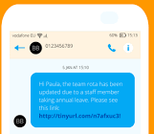
Introduction
Automating manual tasks for managing and messaging contacts saves time and effort.
Streamline bulk contact saving and messaging.
Manually saving and sending messages to thousands of contacts is inefficient, error-prone, and time-consuming.
Large dataset support for contact management.
SMS sending automation for multiple contacts through a simple interface.
Department of CSE(AIML) | THEEMCOE

Slide 4
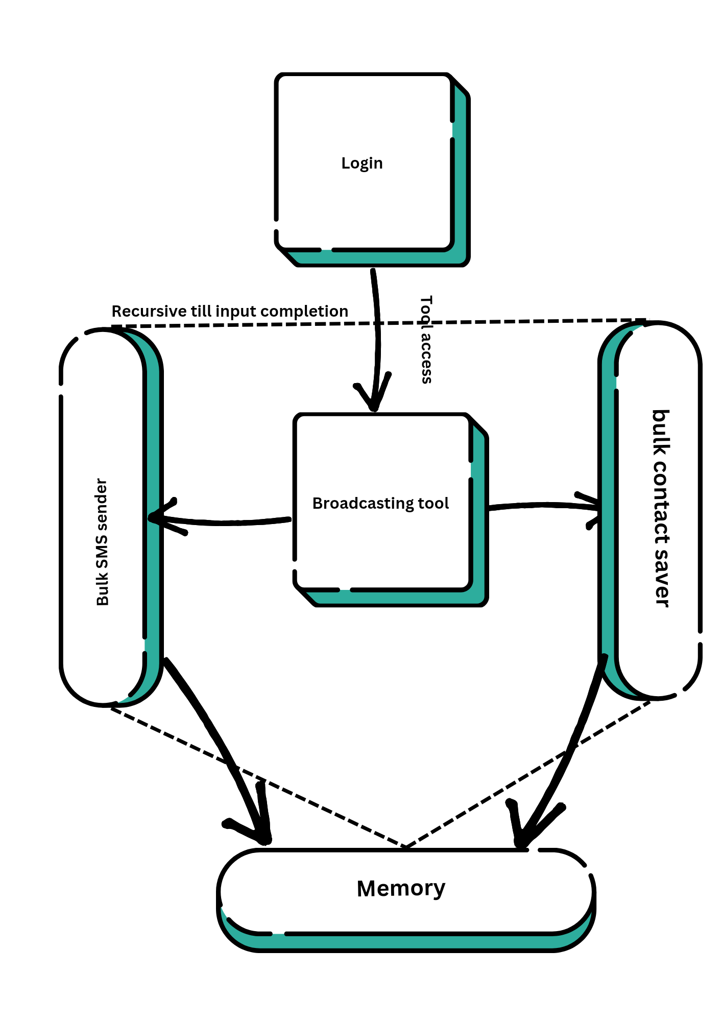
Proposed System
Fig. 1: Block diagram of the broadcasting system
Department of CSE(AIML) | THEEMCOE

Slide 5
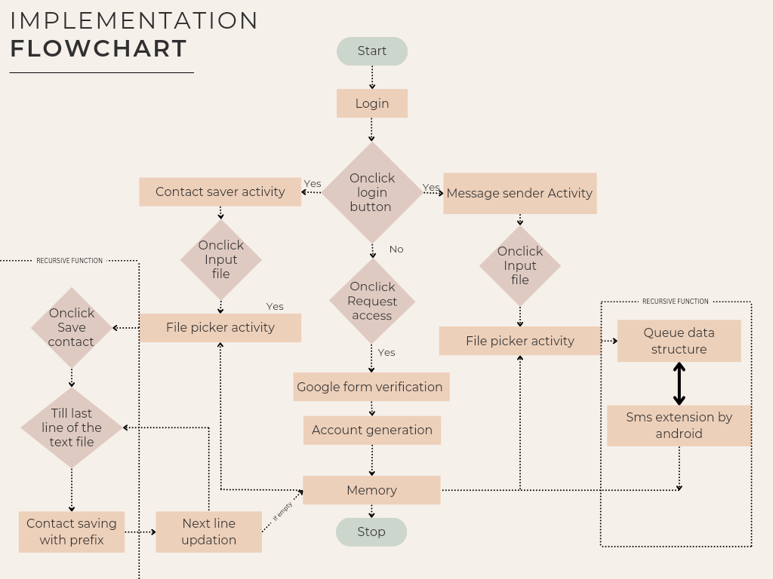
Implementation
Department of CSE(AIML) | THEEMCOE

Slide 6
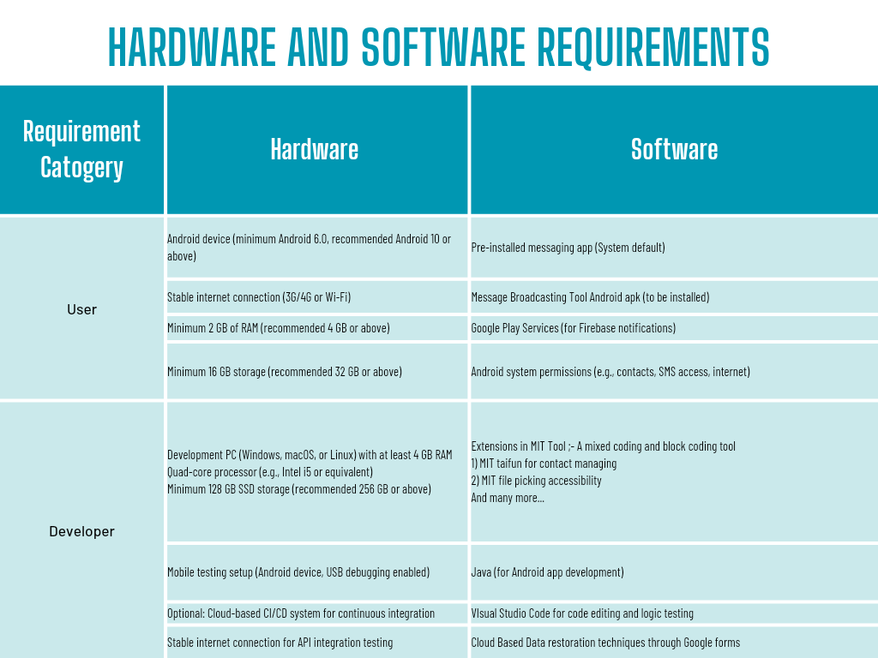
Technologies Used
Department of CSE(AIML) | THEEMCOE

Slide 7
Results and Discussion
1. Implementation Results
- The message Broadcasting Tool can also save 10,000+ contact in approx 1 hour.
- Testing revealed that the app can send up to 500 messages in under 3 minutes with minimal delay when using a stable internet connection.
- The tool allows users to upload a list of contacts from a text file, automating the process of sending bulk messages with ease.
2. Graphs and Performance Comparison
- A comparison of message delivery time between our tool and similar existing systems (e.g., native WhatsApp broadcasting, Twilio) shows a 20% faster delivery time when broadcasting 100 messages.
- Performance under load: The tool performs consistently up to 1,000 contacts without a noticeable increase in processing time.
3. Inferences
- The app performed optimally in smaller batches, but network reliability affects the overall speed for larger groups.
- API rate limits (e.g., for WhatsApp) could impact message delivery when broadcasting at scale, and this can be an area for improvement in future versions.
4. Upcoming Work
- Integration with more messaging platforms (e.g., Telegram, Email broadcasting) is planned for future updates.
- Improving the user interface to make it even more intuitive, especially for non-technical users.
- Adding more detailed logging features for message tracking and failure recovery.
5. Implementation (GUI/Frontend)
- The app uses a simple and user-friendly interface built using MIT App Inventor, making it easy for users to upload contacts and manage broadcasts.
- Backend integrations (Firebase, SQLite) ensure that all contact and message data are securely stored and easily accessible.
Department of CSE(AIML) | THEEMCOE

Slide 8
Conclusion and Future Work
1. Conclusion:
- The Ultimate Message Broadcasting Tool provides a user-friendly solution for sending bulk messages through platforms like and SMS.
- By automating the broadcasting process, it reduces manual effort and saves time, especially for large-scale communication needs (e.g., announcements, marketing).
- The app successfully integrates contact management, message scheduling, and multi-platform support, making it a valuable tool for businesses, educational institutions, and other organizations.
2. Future Work:
- Platform Expansion: Future versions of the app will include support for additional messaging platforms such as Telegram, Email, whatsapp and social media.
- Enhanced Analytics: Implementing detailed analytics for message delivery status, response rates, and user engagement tracking.
- UI/UX Improvements: Further refining the user interface to make the app more accessible to non-technical users and improve the overall user experience.
- Scalability: Optimizing the tool to handle larger datasets, ensuring better performance with more than 10,000 recipients at once.
- Security Enhancements: Incorporating stronger encryption and data privacy measures to protect user information and communication content.
Department of CSE(AIML) | THEEMCOE

Slide 9
References
**References**
1. G. Kiefer, "MIT App Inventor for Android App Development," MIT App Inventor, 2023. [Online]. Available: https://appinventor.mit.edu/explore. Accessed: September 20, 2024.
2. L. Ortega, "Pura Vida Apps: FileTools Extension," Pura Vida Apps, 2023. [Online]. Available: https://puravidaapps.com/filetools.php. Accessed: September 22, 2024.
3. J. Vasquez, "Firebase Cloud Messaging: A Complete Guide," Firebase Documentation, 2024. [Online]. Available: https://firebase.google.com/docs/cloud-messaging. Accessed: September 24, 2024.
4. R. Kumar, "WhatsApp Business API Documentation," Facebook Developers, 2023. [Online]. Available: https://developers.facebook.com/docs/whatsapp. Accessed: September 25, 2024.
5. M. Hayashi, "Twilio SMS API: Sending Bulk SMS," Twilio Developer Documentation, 2023. [Online]. Available: https://www.twilio.com/docs/sms/send-messages. Accessed: September 26, 2024.
6. D. Palmer, "SQLite for Local Database Management," SQLite Documentation, 2024. [Online]. Available: https://www.sqlite.org/about.html. Accessed: September 28, 2024.
7. B. O'Connor, "Understanding Android Permissions," Android Developer Documentation, 2023. [Online]. Available: https://developer.android.com/guide/topics/permissions. Accessed: September 30, 2024.
Department of CSE(AIML) | THEEMCOE

Slide 10
Thank You !!!
Department of CSE(AIML) | THEEMCOE

Slide 11
Q & A
Department of CSE(AIML) | THEEMCOE

